Slide 1


Static
Dynamic
From Static to Dynamic representations of resting-state Functional Connectivity MRI
University of Melbourne – Septembre 25, 2017
Functional Connectivity
Functional Connectivity
Raphaël Liégeois

Slide 2
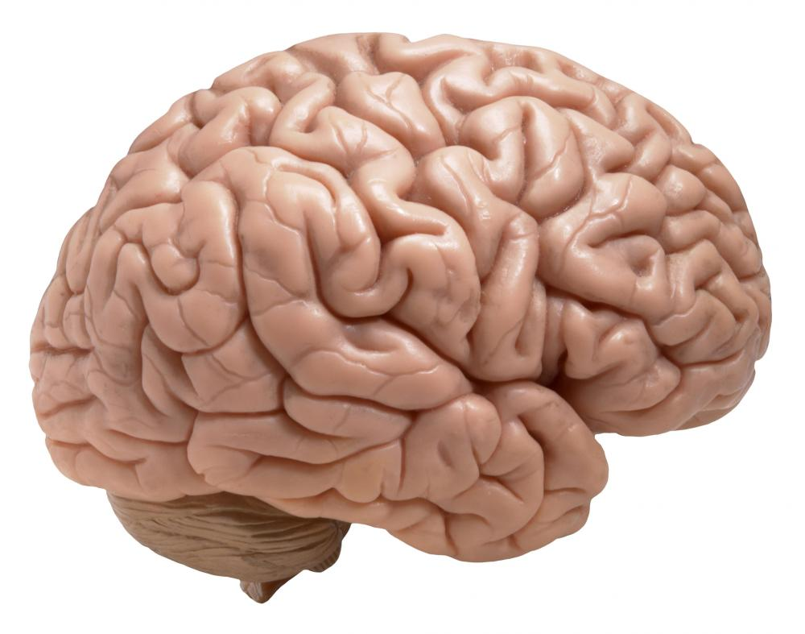
Functional data (e.g. fMRI)
FC matrix
Functional connectivity (FC)
“Statistical dependence between two time series” (Friston, 2011).
Intensity in different ROIs
ROIs
Classically measured by the correlation between time series.
Time
ROIs

Slide 3
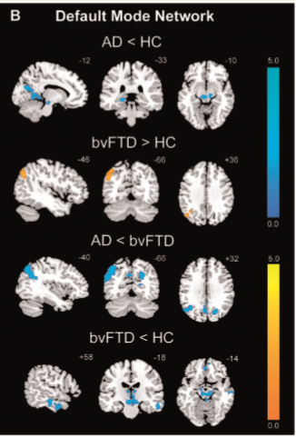
Links to... disease
FC matrix
ROIs
ROIs
Zhou et al., Brain (2010).

Slide 4
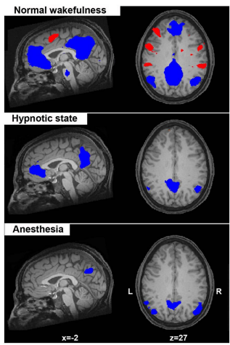
Links to... consciousness
FC matrix
ROIs
ROIs
Heine et al., Frontiers in Psychology (2012).

Slide 5
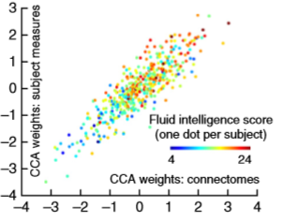
Links to... behavior
FC matrix
ROIs
ROIs
Smith et al., Nature Neuroscience (2015).

Slide 7
Static
Dynamic
Static
Dynamic
From Static to Dynamic representations of resting-state Functional Connectivity MRI
University of Melbourne – Septembre 25, 2017
Functional Connectivity
Raphaël Liégeois

Slide 8



Morning Noon Afternoon Evening

Slide 9



Slide 10
“Dynamic”
1
Temporal ordering information
2
“Static”

Slide 11
Functional data (e.g. fMRI)
Functional connectivity (FC)
“Statistical dependence between two time series” (Friston, 2011).
FC matrix
Intensity in different ROIs
ROIs
Classically measured by the correlation between time series.
Time
ROIs

Slide 12
Functional data (fMRI)
FC measured by the correlation
ROI
ROI
Time (N points)
ROI
ROI
N points
FC measured by the correlation does not take the temporal information into account
“Static” approach

Slide 13
From Static to Dynamic representations of Functional Connectivity MRI
The Singapore Bioimaging Consortium – Septembre 14, 2017
1. Which dynamical model to represent fMRI time series?
2. Linking dynamical markers of FC to behavior

Slide 14
From Static to Dynamic representations of Functional Connectivity MRI
The Singapore Bioimaging Consortium – Septembre 14, 2017
1. Which dynamical model to represent fMRI time series?
2. Linking dynamical markers of FC to behavior

Slide 15
We need a model of fMRI time series that...
Encodes static FC information (i.e., correlation)
Encodes the ordering of fMRI time points
Reproduces fMRI properties (e.g., FC fluctuations)
A simple model encoding (1) and (2) is the 1st order autoregressive (AR-1) model:
x_{t} = A₁ . x_{t-1}+ ε_{t}
where
A₁ is a model parameter
ε_{t} is white noise

Slide 16
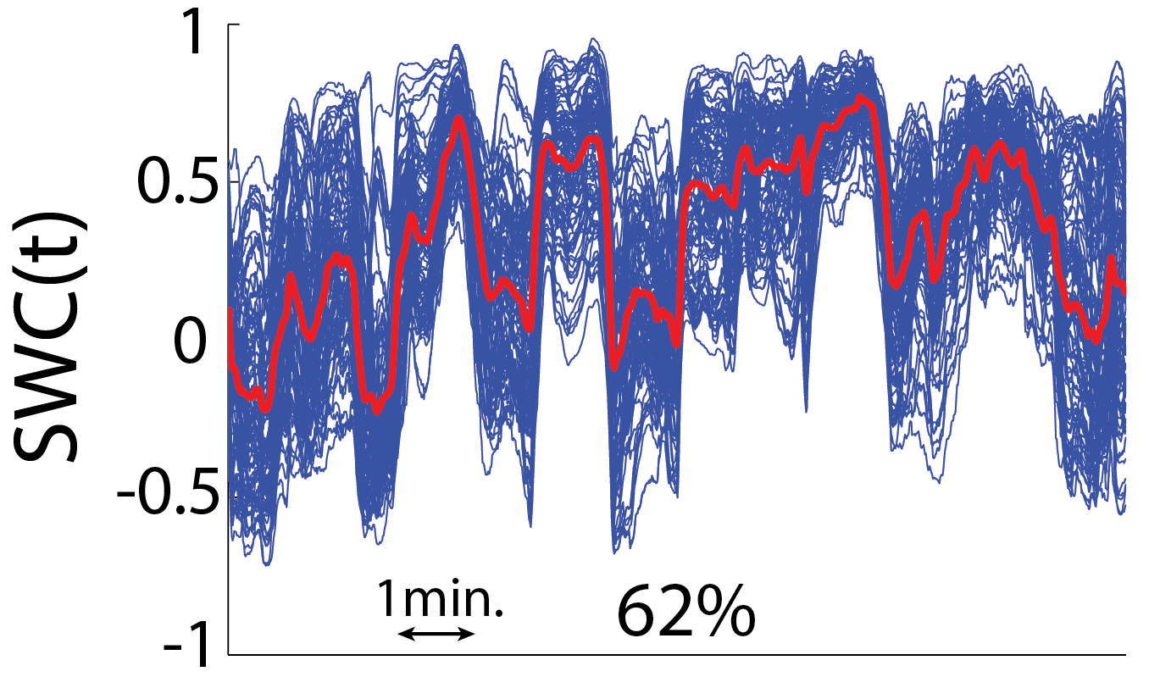
Which fMRI properties should AR capture?
Static FC information
(Biswal et al., 1995)
Temporal FC fluctuations
(e.g. Allen et al. 2014, Zalesky et al. 2014, Preti et al. 2017 )
To be tested...
Identify AR model from original data
Generate surrogates from this model
Compare surrogates vs. original
By construction

Slide 17
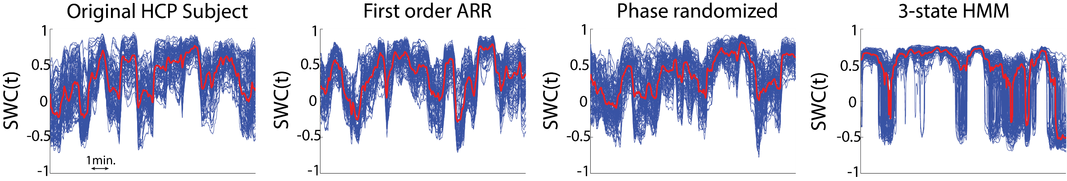
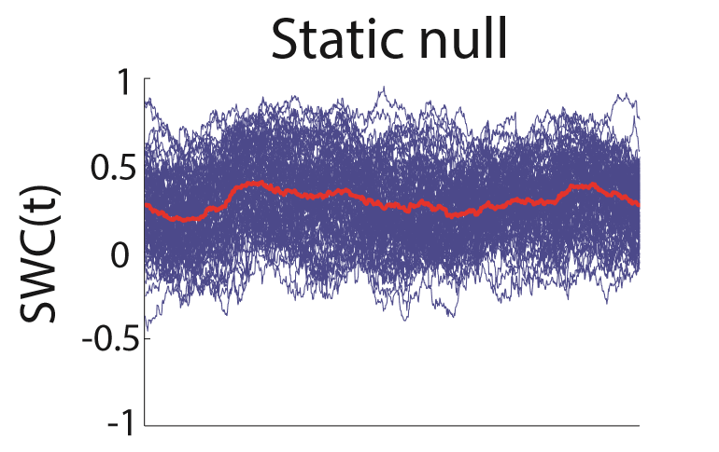
Does AR preserve FC fluctuations (Liégeois et al., 2017)?
Dataset
S900 Human Connectome Project dataset (Smith et al., 2013)
ICA-FIX (minimal) preprocessing
Parcellation in 114 ROIs (Yeo et al., 2011), 1200 time points (TR=0.72 sec)
Use of a 1st order AR model of fMRI time series
Comparison of different FC fluctuations statistics in original and surrogate data
1. AR model reproduces whole-brain fluctuations for 99% of low-motion subjects
2. AR model reproduces, on average, 99.4% of inter-ROI pairwise fluctuations

Slide 18
Which fMRI properties should AR capture?
Static FC information
(Biswal et al., 1995)
Temporal FC fluctuations
(e.g. Allen et al. 2014, Zalesky et al. 2014, Preti et al. 2017 )
To be tested...
Identify AR model from original data
Generate surrogates from this model
Compare surrogates vs. original
By construction
AR-1 seems to capture most FC fluctuations,
even if... (Griffa et al. 2017, Abrol et al., 2017)

Slide 19
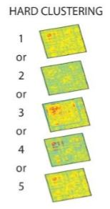
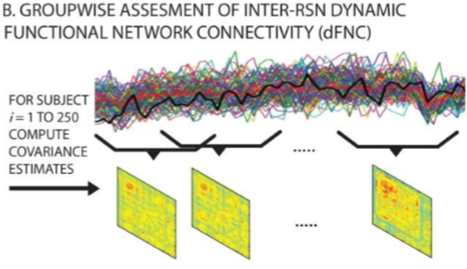
Links and differences to the “state-based” approach
Allen et al., Cerebral Cortex (2014); Abrol et al., Neuroimage (2017)

Slide 20
Links and differences to the “state-based” approach
Allen et al., Cerebral Cortex (2014); Abrol et al., Neuroimage (2017)
 | State-based “time-resolved” approach | AR “dynamic” approach
Pros | Time-resolved information Interpretability of states | Concision Does not rely on parameters
Cons | Choice of parameters (w,K) Data “explosion” | Interpretation of “A” No time-resolved information

Slide 21
We use the following AR-1 model of fMRI time series:
AR-1 captures (most) FC fluctuations
A₁ is the dynamic FC marker we propose
x_{t} = A₁ . x_{t-1}+ ε_{t}
But: capturing statistical properties does not mean capturing biologically relevant information

Slide 22
From Static to Dynamic representations of Functional Connectivity MRI
The Singapore Bioimaging Consortium – Septembre 14, 2017
1. Which dynamical model to represent fMRI time series?
2. Linking dynamical markers of FC to behavior

Slide 23
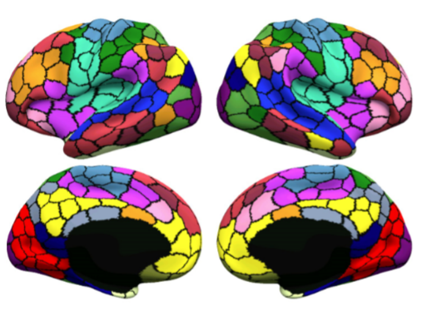
Dataset and processing
HCP dataset
S1200 Human Connectome Project dataset (Smith et al., 2013)
917 subjects
Between 1 and 4 runs/subject
ICA-FIX (minimal) preprocessing + global signal regression
Parcellation in 400 ROIs (Schaefer et al., 2017), 1200 time points (TR=0.72 sec)
Static FC markers are obtained from the fMRI correlation matrix, for each subject
Dynamic FC markers are obtained from a 1st order AR model of fMRI time series
Static and Dynamic FC markers are linked to 60 HCP behavioral measures
Schaefer et al., 2017
fMRI data matrix/subject
Static FC marker Dynamic FC marker
*
60 behavioral measures

Slide 24

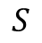
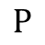
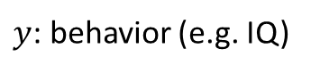
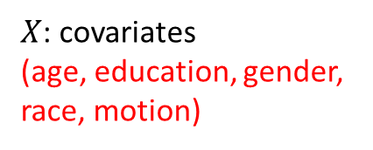
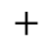
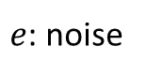
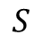
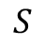
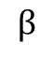
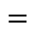
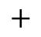
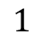
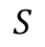
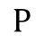
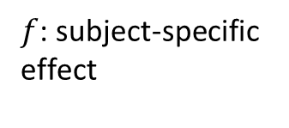
The variance component model (Sabuncu et al., 2016)
$$y=Xβ+f+e$$
$$P$$
$$1$$
$$S$$
$$S$$
$$P$$
$$S$$
$$S$$
$$=$$
$$×$$
$$+$$
$$+$$
$y$: behavior (e.g. IQ)
$X$: covariates
(age, education, gender, race, motion)
$$β$$
$f$: subject-specific
effect
$e$: noise

Slide 25
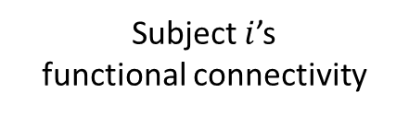
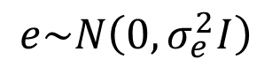
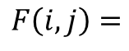
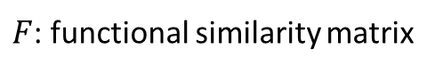
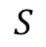
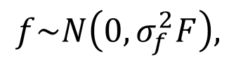
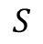
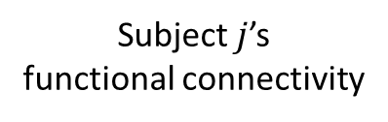
The variance component model (Sabuncu et al., 2016)
$$y=Xβ+f+e$$
$$f\sim N\left(0, σ_{f}^{2}F\right),$$
$$e\sim N\left(0, σ_{e}^{2}I\right)$$
$$S$$
Subject $i$’s
functional connectivity
Subject $j$’s
functional connectivity
$$S$$
(
)
$$F\left(i, j\right)=$$
correlation
,
$F$: functional similarity matrix

Slide 26
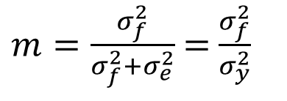
The variance component model (Sabuncu et al., 2016)
$$y=Xβ+f+e$$
$$f\sim N\left(0, σ_{f}^{2}F\right),$$
$$e\sim N\left(0, σ_{e}^{2}I\right)$$
$m=\frac{σ_{f}^{2}}{σ_{f}^{2}+σ_{e}^{2}}$ = $\frac{σ_{f}^{2}}{σ_{y}^{2}}$
“Connectometricity”

Slide 27
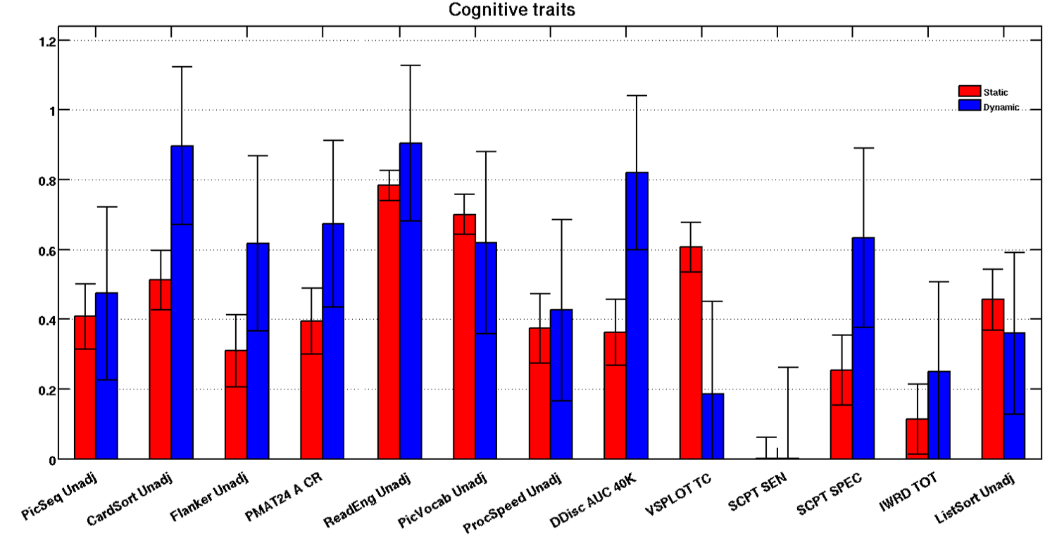
Results on behaviors (Liégeois et al., In Preparation)
Connectometricity

Slide 28
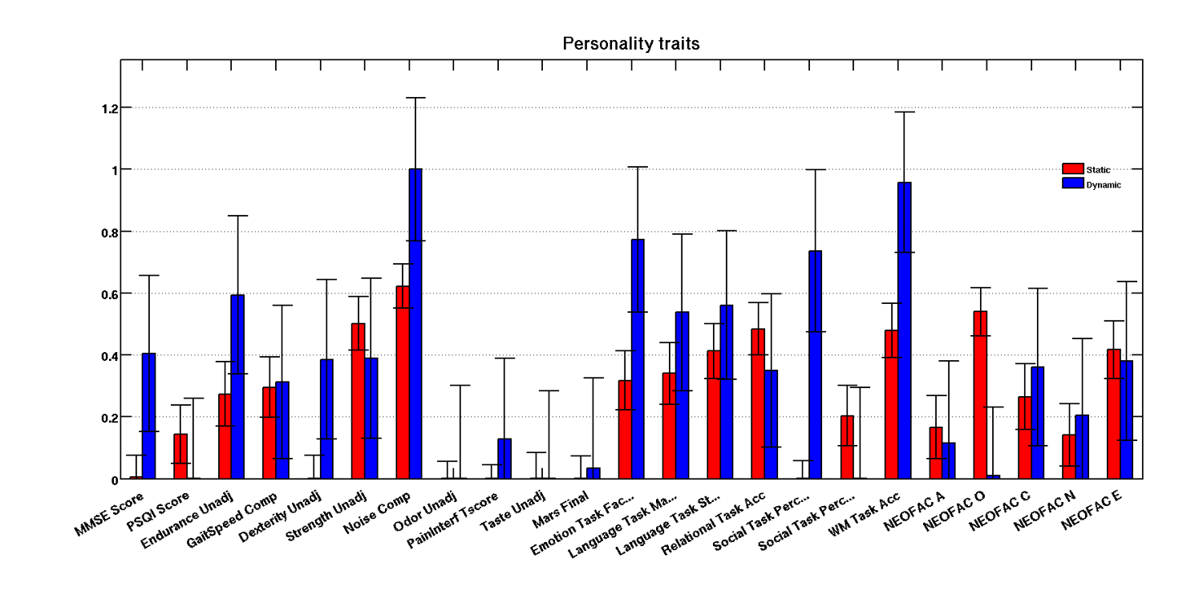
Results on behaviors (Liégeois et al., In Preparation)
Connectometricity

Slide 29
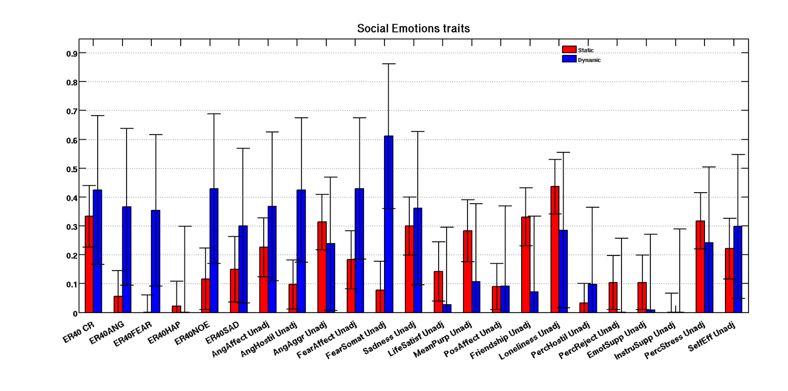
Results on behaviors (Liégeois et al., In Preparation)
Connectometricity
On average over all the measures, static FC markers explain 25% of the phenotypic variance; dynamic FC markers explain 35% of it.

Slide 30
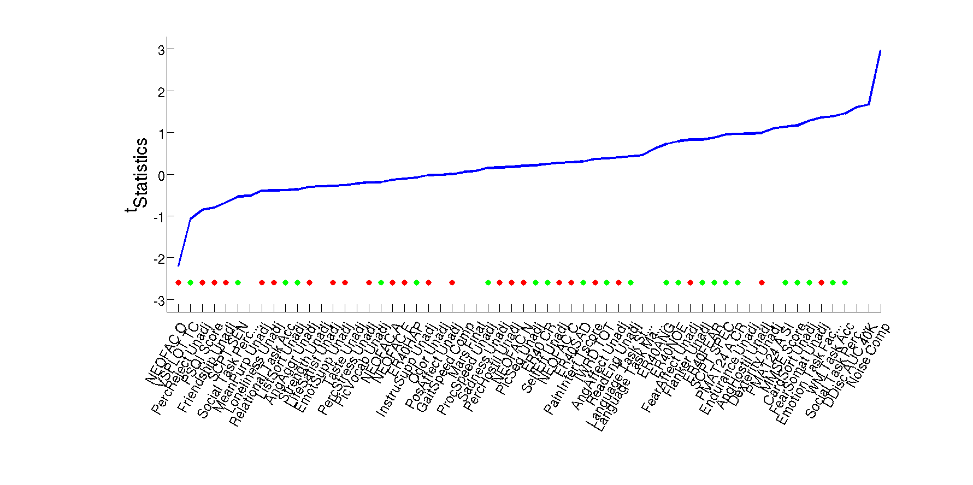
Do static and dynamic FC markers capture different behaviors?
Static FC > Dynamic FC Dynamic FC > Static FC
Performance/task
Self-reported
Self-reported perceptions of the availability of friends with whom to interact or affiliate
Accuracy in a working memory task
Static and dynamic FC markers seem to capture complementary behavioral information

Slide 31
Conclusion
1. Static vs. dynamic models
2. AR-1 model reproduces most fMRI properties by including dynamical FC information
3. Static and dynamic FC markers seem to capture different behabioral measures
Static FC > Dynamic FC Dynamic FC > Static FC
Temporal ordering information

